Slide 1




Wavecon Telecom Analysis
5G LAUNCH IMPACT ON WAVECON'S REVENUE
Presented by : Sriraj Acharya

Slide 2


Introduction
Wavecon, a leading telecom provider in India, introduced its 5G services in May 2022 across major cities alongside other telecom companies. This analysis examines the performance of Wavecon's 5G rollout in 15 key urban centers Mumbai , Delhi , Bangalore, Hyderabad, aiming to uncover insights into the impact of 5G on revenue, plan performance, and key performance indicators (KPIs). The findings will inform strategic decisions for future growth and optimization.

Slide 3
Objectives
What is the impact of the 5G launch on our revenue?
2.Which KPI is underperforming after the 5G launch?
3.After the 5G launch, which plans are performing well in terms of revenue? Which plans are not performing well?
4.Is there any plan affected largely by the 5G launch? Should we continue or discontinue that plan?
5.Is there any plan that is discontinued after the 5G launch? What is the reason for it?`

Slide 4

Dashboard

Slide 5




1.What is the impact of the 5G launch on revenue ?
Revenue Dip
Before 5G was launched, Wavecon's revenue was $16 billion. After the launch, revenue dropped slightly to $15.9 billion. This suggests a need to investigate what caused this change and find ways to increase revenue.

Slide 6




2. Which KPI is underperforming after the 5G launch?
Total Revenue
Total revenue slightly decreased from $16 billion to $15.9 billion.
Active Users
The active user base decreased from 84.4 million to 77.4 million
Total Unsubscribed Users
The total number of unsubscribed users increased from 5.6 million to 7 million

Slide 7


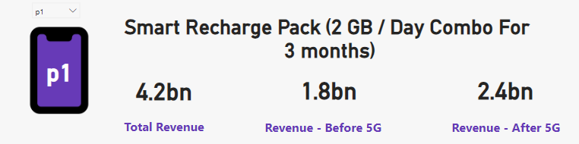
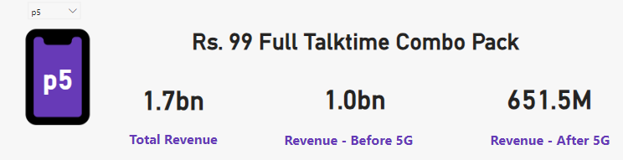
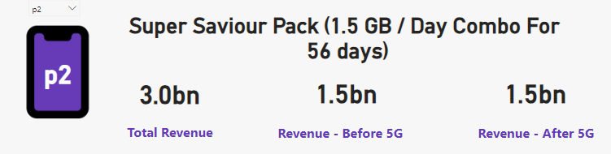
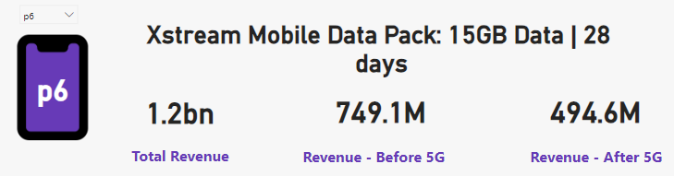
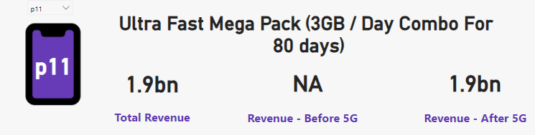
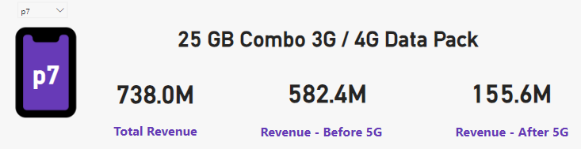
3.After the 5G launch, which plans are performing well in terms of revenue? Which plans are not performing well?
Good performing Plan After 5G Launch
Bad performing Plan After 5G Launch

Slide 8
4. Is there any plan affected largely by the 5G launch? Should we continue or discontinue that plan?
P1: Smart Recharge Pack (2 GB / Day Combo for 3 Months)
Revenue Before: $1.8 billion
Revenue After: $2.4 billion
P11: Ultra Fast Mega Pack (3GB / Day Combo for 80 Days)
Revenue: $1.9 billion
New plan launched during the 5G launch, performing well.
P12: Ultra Duo Data Pack (1.8GB / Day Combo for 55 Days)
Revenue: $1.2 billion
New plan launched during the 5G launch, performing well.
P7: 25 GB Combo 3G / 4G Data Pack
Revenue Before: $582.4 million
Revenue After: $155.6 million
Positive Impact
Negative Impact

Slide 9
5.Is there any plan that is discontinued after the 5G launch? What is the reason for it?
1. P8: Daily Saviour (1 GB / Day)
Validity: 1 Day
Reason for Discontinuation: The 1GB data plan with a 1-day validity period is insufficient for the increased data consumption driven by 5G technology. Consumers now demand plans with more data and longer validity periods.
2. P9: Combo Top-Up (14.95 Talktime and 300 MB Data)
Reason for Discontinuation: With the rise of 5G, consumer preferences have shifted away from plans offering limited talk time and minimal data. The faster speeds of 5G have increased data consumption, making such limited plans impractical. Additionally, Wavecon offers the P5 (Rs. 99 Full Talktime Combo Pack), which provides better value.
3. P10: Big Combo Pack (6 GB / Day)
Validity: 3 Days
Reason for Discontinuation: Despite offering a significant amount of data, the short validity period of only 3 days made this plan less appealing to consumers. This could be the reason Wavecon decided to discontinue this plan.

Slide 10


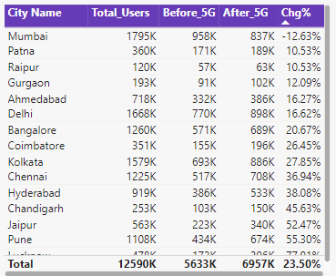

Recommendation
1. Enhancing Underperforming Plans for Revenue Growth
2. Total Unsubscribed Users (TUSU change)

Slide 11


Recommendation
3.Success and Future Growth of Top Performing Plan

Slide 12
Thank You

